Slide 1


Python Adv (Geavenceerd)
By Yilmaz Mustafa

Slide 2
Web Scraping

Slide 3
Web scraping is a general term for techniques involving automating the gathering of data from a website.
In this section we will learn how to use Python to conduct web scraping tasks, such as downloading images or information off a website.

Slide 4
In order to web scrape with Python we need to understand the basic concepts of how a website works.
When a browser loads a website, the user gets to see what is known as the “front-end” of the website.

Slide 5


Slide 6


Slide 7


Slide 8
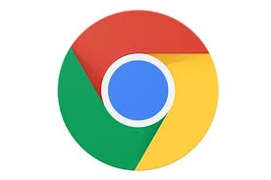

Slide 10
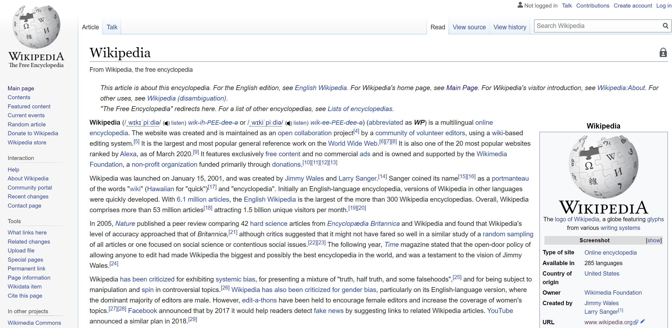

Slide 11
<!DOCTYPE html>
<html>
<head>
<title>Title on
Browser Tab</title>
</head>
<body>
<h1> Website
Header </h1>
<p> Some
Paragraph </p>
<body>
</html>

Slide 12

<!DOCTYPE html>
<html>
<head>
<title>Title on
Browser Tab</title>
</head>
<body>
<h1> Website
Header </h1>
<p> Some
Paragraph </p>
<body>
</html>

Slide 13
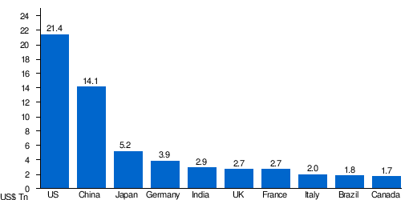
<!DOCTYPE html>
<html>
<head>
<title>Title on
Browser Tab</title>
</head>
<body>
<h1> Website
Header </h1>
<p> Some
Paragraph </p>
<body>
</html>

Slide 14
<!DOCTYPE html>
<html>
<head>
<title>Title on
Browser Tab</title>
</head>
<body>
<h1> Website
Header </h1>
<p> Some
Paragraph </p>
<body>
</html>
[“Germany”, “France”, “Spain”]

Slide 15
Main things we need to understand
Rules of Web Scraping
Limitations of Web Scraping
Basic HTML and CSS

Slide 16
Rules of Web Scraping
Always try to get permission before scraping!
If you make too many scraping attempts or requests your IP Address could get blocked!
Some sites automatically block scraping software.

Slide 17
Limitations of Web Scraping
In general every website is unique, which means every web scraping script is unique.
A slight change or update to a website may completely break your web scraping script.

Slide 18
Main front end components of a website
<!DOCTYPE html>
<html>
<head>
<title>Title on Browser Tab</title>
</head>
<body>
<h1> Website Header </h1>
<p> Some Paragraph </p>
<body>
</html>
p{
color: red;
font-family: courier;
font-size: 160%;
}
.someclass{
color: green;
font-family: verdana;
font-size: 300%;
}
#someid{
color: blue;
}
var values = ["Volvo", "Saab", "Fiat"];
var person = {
firstName: "John",
lastName: "Doe",
age: 50,
eyeColor: "blue"
};
HTML
CSS
JS

Slide 19
When viewing a website, the browser doesn’t show you all the source code behind the website, instead it shows you the HTML and some CSS and JS that the website sends to your browser.

Slide 20
HTML is used to create the basic structure and content of a webpage
CSS is used for the design and style of a web page, where elements are placed and how it looks
JavaScript is used to define the interactive elements of a webpage

Slide 21
For effective basic web scraping we only need to have a basic understanding of HTML and CSS.
Python can view these HTML and CSS elements programmatically, and then extract information from the website.
Let’s explore HTML and CSS in more detail.

Slide 22
HTML is Hypertext Markup Language and is present on every website on the internet.
You can right-click on a website and select “View Page Source” to get an example.
Let’s see a small example of HTML code.

Slide 23
<!DOCTYPE html>
<html>
<head>
<title>Title on Browser Tab</title>
</head>
<body>
<h1> Website Header </h1>
<p> Some Paragraph </p>
<body>
</html>

Slide 24
<!DOCTYPE html>
<html>
<head>
<title>Title on Browser Tab</title>
</head>
<body>
<h1> Website Header </h1>
<p> Some Paragraph </p>
<body>
</html>

Slide 25
<!DOCTYPE html>
<html>
<head>
<title>Title on Browser Tab</title>
</head>
<body>
<h1> Website Header </h1>
<p> Some Paragraph </p>
<body>
</html>

Slide 26
<!DOCTYPE html>
<html>
<head>
<title>Title on Browser Tab</title>
</head>
<body>
<h1> Website Header </h1>
<p> Some Paragraph </p>
<body>
</html>

Slide 27
CSS stands for Cascading Style Sheets.
CSS gives “style” to a website, such as changing colors and fonts.
CSS uses tags to define what html elements will be styled.

Slide 28
<!DOCTYPE html>
<html>
<head>
<link rel="stylesheet" href="styles.css">
<title>Some Title</title>
</head>
<body>
<p id=‘para2’> Some Text </p>
<body>
</html>

Slide 29
<!DOCTYPE html>
<html>
<head>
<link rel="stylesheet" href="styles.css">
<title>Some Title</title>
</head>
<body>
<p id=‘para2’> Some Text </p>
<body>
</html>

Slide 30
<!DOCTYPE html>
<html>
<head>
<link rel="stylesheet" href="styles.css">
<title>Some Title</title>
</head>
<body>
<p id=‘para2’> Some Text </p>
<body>
</html>

Slide 31
Example of the style.css file:
#para2 {
color: red;
}

Slide 32
<!DOCTYPE html>
<html>
<head>
<link rel="stylesheet" href="styles.css">
<title>Some Title</title>
</head>
<body>
<p class=‘cool’> Some Text </p>
<body>
</html>

Slide 33
Example of the style.css file:
.cool {
color: red;
font-family: verdana;
}

Slide 34
p{
color: red;
font-family: courier;
font-size: 160%;
}
.someclass{
color: green;
font-family: verdana;
font-size: 300%;
}
#someid{
color: blue;
}

Slide 35
Don’t worry about memorizing this! We’ll see lots of examples, main ideas to note:
HTML contains the information
CSS contains the styling
We can use HTML and CSS tags to locate specific information on a page

Slide 36
To web scrape with Python we can use the BeautifulSoup and requests libraries.
These are external libraries outside of Python so you need to install them with either conda or pip at your command line.

Slide 37
Directly at your command line use:
pip install requests
pip install lxml
pip install bs4
Or for Anaconda distributions, use conda install instead of pip install.

Slide 38
Let’s work through some examples of web scraping with Python!

Slide 39
Setting Up
For Web Scraping

Slide 40
Install the necessary libraries
Explore how to inspect elements and view source of a webpage
Note: We will suggest you use Chrome so you can follow along exactly as we do, but these tools are available in all major browsers.

Slide 41
Grabbing a Page Title

Slide 42
Grabbing All
Elements of a Class

Slide 43
We previously mentioned a big part of web scraping with the BeautifulSoup library is figuring out what string syntax to pass into the soup.select() method.
Let’s go through a table with some common examples (these make a lot of sense if you know CSS syntax)

Slide 44
Syntax | Match Results
soup.select(‘div’) | All elements with ‘div’ tag
soup.select(‘#some_id’) | Elements containing id=’some_id’
soup.select(‘.some_class’) | Elements containing class = ‘some_class’
soup.select(‘div span’) | Any elements named span within a div element.
soup.select(‘div > span’) | Any elements named span directly within a div element, with nothing in between.

Slide 45
Grabbing an Image

Slide 46
Now that we understand how to grab text information based on tags and element names, let’s explore how to grab images from a website.
Images on a website typically have their own URL link (ending in .jpg or .png)

Slide 47
Beautiful Soup can scan a page, locate the <img> tags and grab these URLs.
Then we can download the URLs as images and write them to the computer.
Note: You should always check copyright permission before downloading and using an image from a website.

Slide 48
Working with
Multiple Pages and Items

Slide 49
We’ve seen how to grab elements one at a time, but realistically, we want to be able to grab multiple elements, most likely across multiple pages.
This is where we can combine our prior python knowledge with the web scraping libraries to create powerful scripts!

Slide 50
We will use a site specifically designed to practice web scraping: www.toscrape.com
We will practice grabbing elements across multiple pages.
Let’s get started!

Slide 51
Working with
Multiple Pages

Slide 52
Web Scraping Exercises
Overview

Slide 53
Web Scraping
Exercises Solutions

Slide 54


